Slide 1
Making Better Board Games
A Historical and Commercial Guide

Slide 2
Introduction
Increasingly popular and increasingly widespread form of entertainment
What makes a board game critically and commercially successful?
What categories, mechanics, and publishers should a game designer employ?
What historical changes have occurred in the board game market?

Slide 3
The Data
Scraped from Board Game Geek in 2017
Accessible via Kaggle https://www.kaggle.com/gabrio/board-games-dataset

Slide 4
Answering the Questions
Increased ratings (average and Bayesian average) translate into more copies of game owned, and thus, greater commercial success
These serve as a proxy for a game’s commercial and critical success
Also, trained a classifier on games from before and after 2000, to show historical change in market between War and Euro games.
Popular hypothesis of changing market structure

Slide 5
Data Wrangling
Deleted extraneous data and columns, reducing them from 80 to 17
Combined columns such as min and maxplayer into average player, and transformed them into level based groupings (such as few, average, and many)
Deleted games with less five rating as extraneous
Split and transformed categorical data, then turned it into dummy variables
Relatively low number of nan, didn’t need to replace much

Slide 6
Biases of the Data
Reflects the interests of a somewhat limited population, users of Board Game Geek
The commercial data used in these models is all self-reported
Not entirely obvious how average and geekscore translate into actual sales, based on a relationship of self-reported data
Should be clear though, Scrabble is highest owned game on BGG, which is probably reflective of social reality

Slide 7
Board Game EDA
More games made after 2000 than pre-2000
Significant differences in average, category, and mecanic between pre and post-2000 games
Direct correlation between geekscore/average and number of copies of a game owned
Each .03 increase in average translates to 50 more games owned, each .03 increase in geekscore translates to 111 more games owned

Slide 8
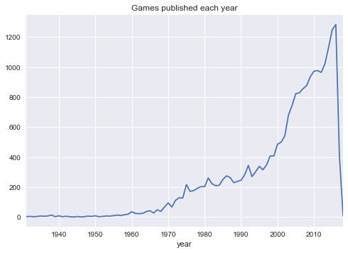
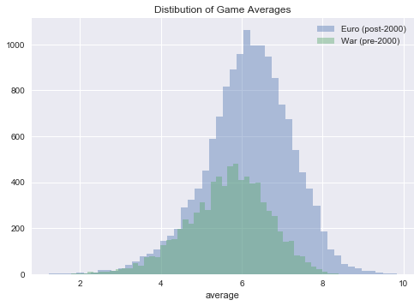
Pre and post 2000 games differ in average, and in number of games published

Slide 9
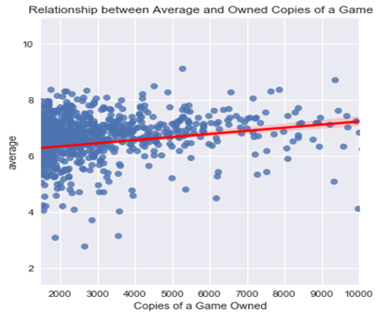
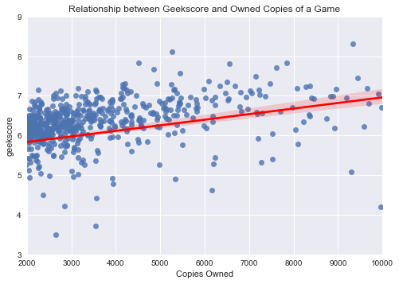
Direct Correlation between geekscore/average and # of copies owned

Slide 10
What do the models do?
First set of models predict what categories can influence geekscore/average
Second set of models are classifiers, which use the data to predict whether a game is a War game or a Euro game, labeling that is based on pre and post 2000 publication dates.

Slide 11
Preprocessing the Data
Transformed some numeric variables into categorical variables, such as gamelength, which I made into “short”, “medium”, and “long”
Turned categorical variables into dummy variables, making a large, sparse dataset

Slide 12
Modeling Procedure
Split into test and training data
Tune the model parameters using GridSearchCV (or for loops)
Fit the model to the training data, and test it on the test data
Try a series of models for each problem, and report the model that performs the best
If necessary, some feature selection

Slide 13
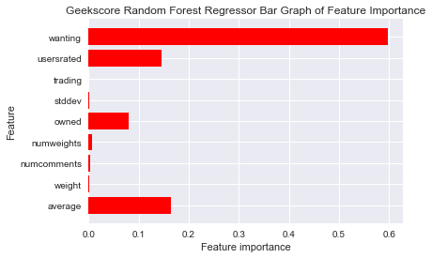
Geekscore Model
-Random Forest Regression Model -Root Mean Squared Error on Training Data: 0.023022710400284016 -Root Mean Squared Error on Test Data: 0.03631883462324047 -Feature Importance filtered at > 0.0001 -Based on this model, the features that are the most predictive of a geekscore concern user engagement, rather than category, mechanic, or length of game.

Slide 14
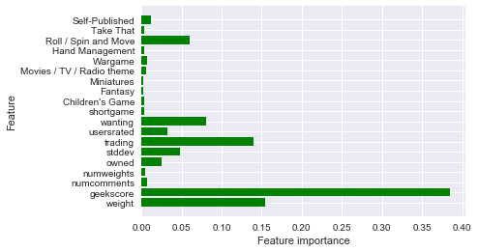
Averages Model
-Random Forest Regression Model -Root Mean Squared Error on Training Data: 0.7132977515882472 -Root Mean Squared Error on Test Data: 0.7493511953604849 -Filtered feature importance at 0.002 -Again, similar features as above-primarily geekscore, wanting, trading, weight, owned, and stdev. -But categories and mechanics play a role here as well

Slide 15
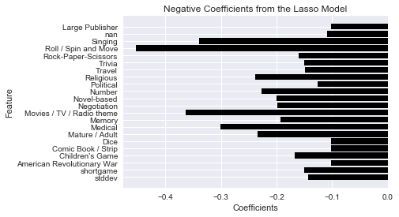
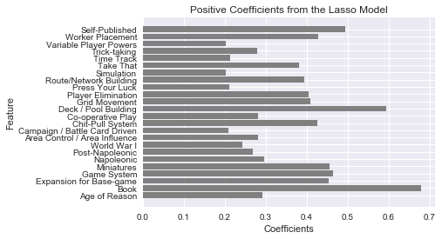
Some categories and mechanics matter a lot
This Lasso Model for averages focused on categories and mechanics--it has a higher RMSE, but it’s interesting. RMSE on train data: 0.8782871750708969, RMSE on test data” 0.8892818363281227

Slide 16
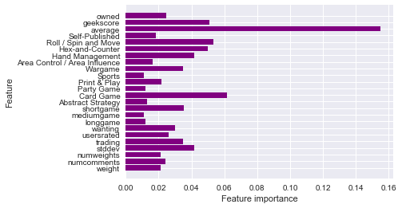
Gametype Classifier
-Random Forest Classifier, trained on a response variable of pre/post 2000 games (War and Euro games respectively -Accuracy on Training Set: 0.7323144886872426 -Accuracy on Test Set: 0.7122161860983424 -Mixture of engagement metrics, (wanting, usersrated), categorie and mechanics (Card Games, Wargames), and features of games (length of game)

Slide 17
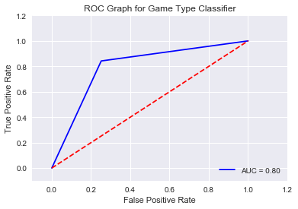
Naive Bayes Text Classifier
-Naive Bayes algorithim, trained on category, mechanic, and publication text data to predict the gametype -Accuracy on training data: 0.873799 -Accuracy on test data: 0.808549

Slide 18
Recommendations
Geekscore and average are a path to commercial viability
Certain mechanics (Negotation) and categories (Movie/TV/Radio Theme) should be avoided
But more generally, geekscore and average are produced by metrics of engagement on the BoardGameGeek site
Modeling suggests that publishers and designers should spend more time promoting their games among BoardGameGeek users, and getting them to engage with games on the site

Slide 19
Conclusion/Future Directions
Classifier validated difference between Euro/War games, but also showed that the story is more complex, need more and better categories
Could incorporate some further data from BoardGameGeek
But a more interesting model would be to account for how games jump into the mass market (i.e. sell > 10,000 copies), and become breakaway hits like Settlers of Catan, Ticket to Ride, or Pandemic

